Slide 1
URD Database Update
April 4, 2026

Slide 2
Project Goals
1. Increase Efficiency Through Technology and Workflow Design
2. Build a Structured and Scalable Acquisition Infrastructure
3. Strengthen Organizational Capacity and Volunteer Infrastructure
4. Ensure Data Integrity and Quality Standards

Slide 3
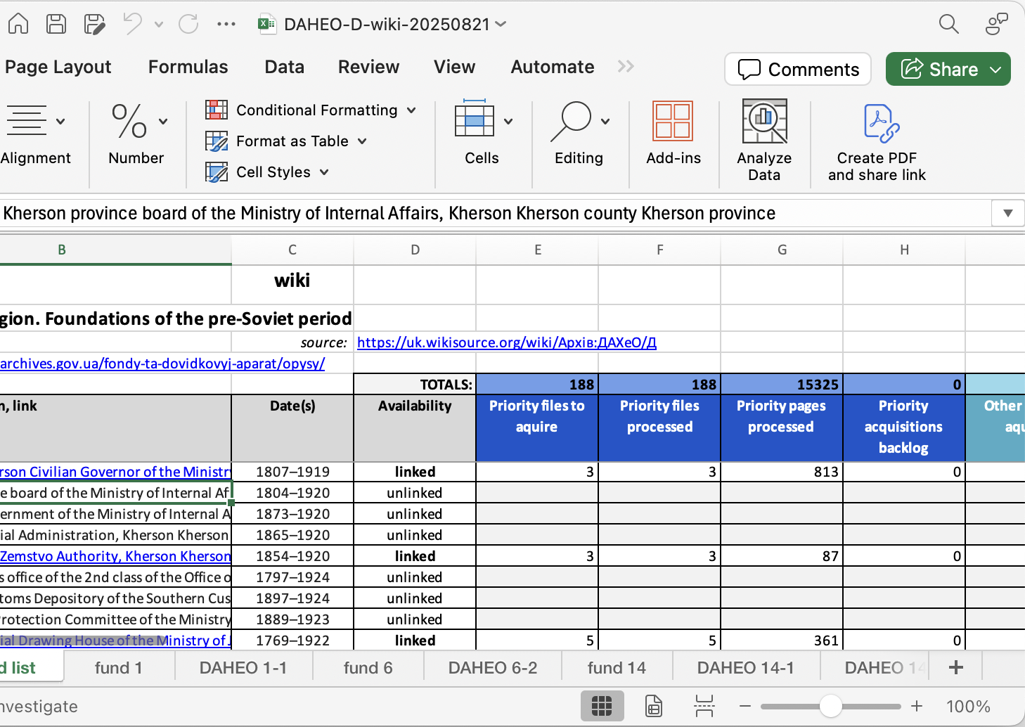
URD Data Problem
With Google Drive spreadsheets,
View and Data are not separated
Labor intensive to maintain
Fragile multi-tab relationship structure
Not amenable to multi-person access
Hard to revise sheet structure
Hard to scale

Slide 4

The Solution
Replace Google Drive with a Database that
Separates data from view
Is easy to maintain and evolve
Can scale
Allows multiple concurrent users
Replaces multi-tab spreadsheets with evolvable, role-specific views
Replaces cross-sheet process reporting formulas with automated roll-ups
Provides built-in back-up, journaling of data changes, and commenting
Facilitates further automation, such as AI-assisted triage, etc.

Slide 5
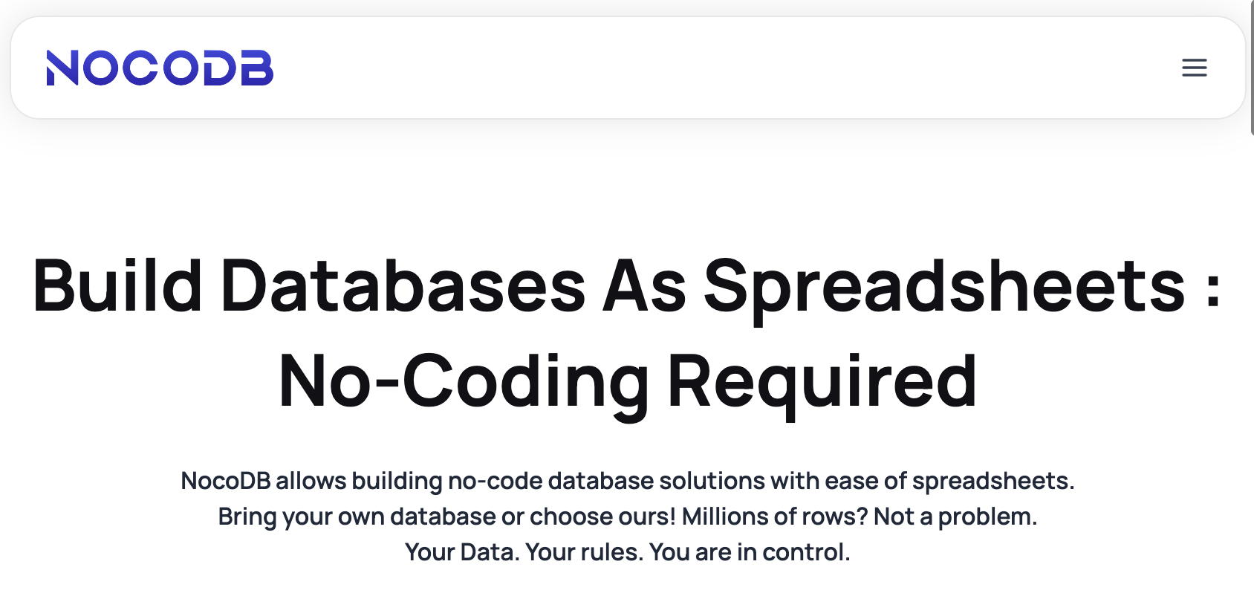
Candidate Database Platform: NocoDB
Low cost
Easy to learn (like AirTable)
Opensource
Open database
Available as hosted solution
Can be self-hosted too
https://nocodb.com/

Slide 6
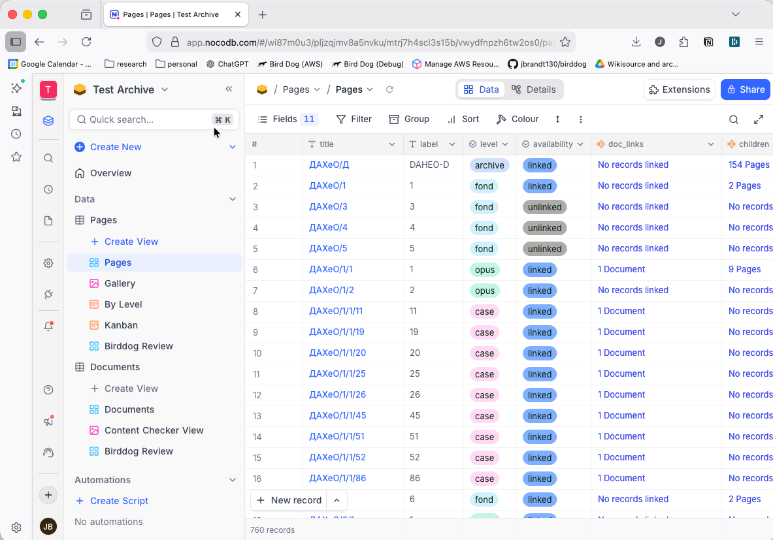
NocoDB Web App

Slide 7
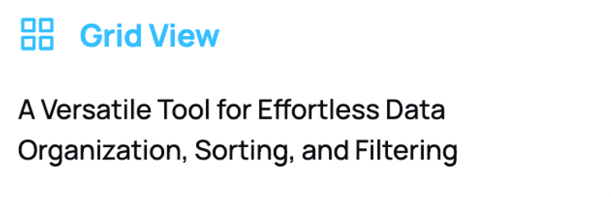
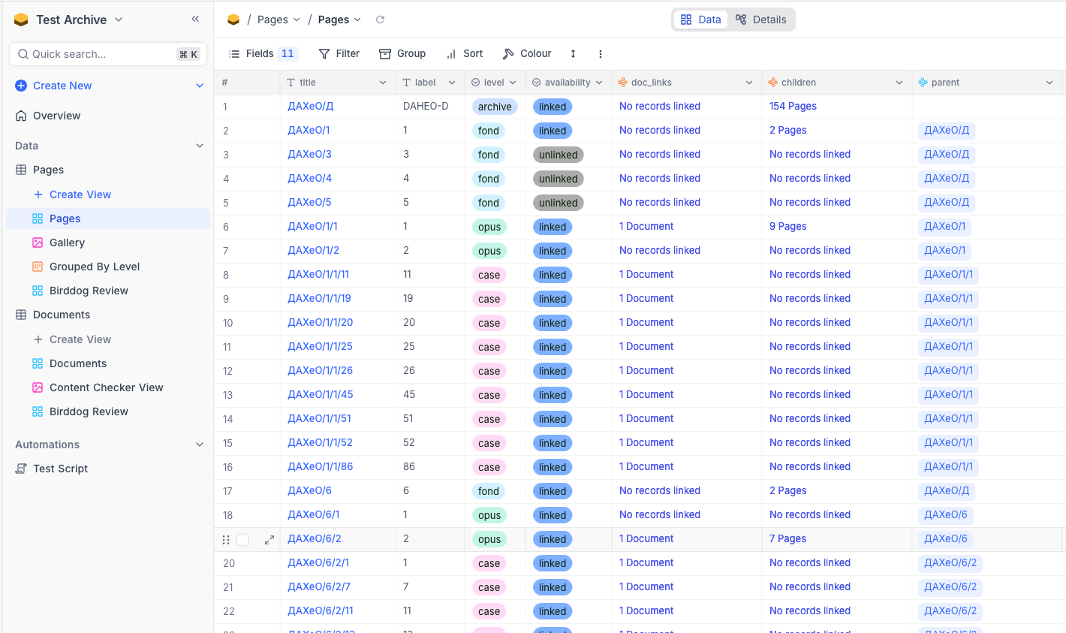
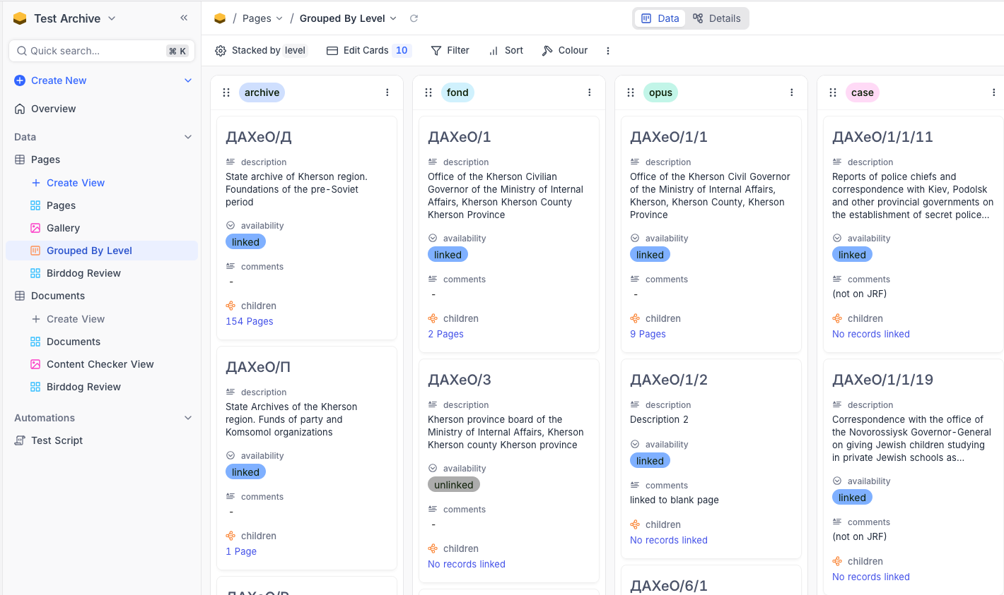
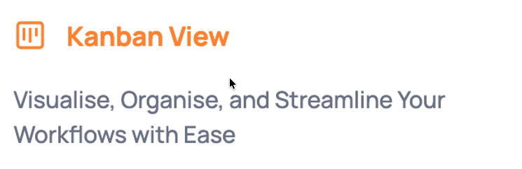

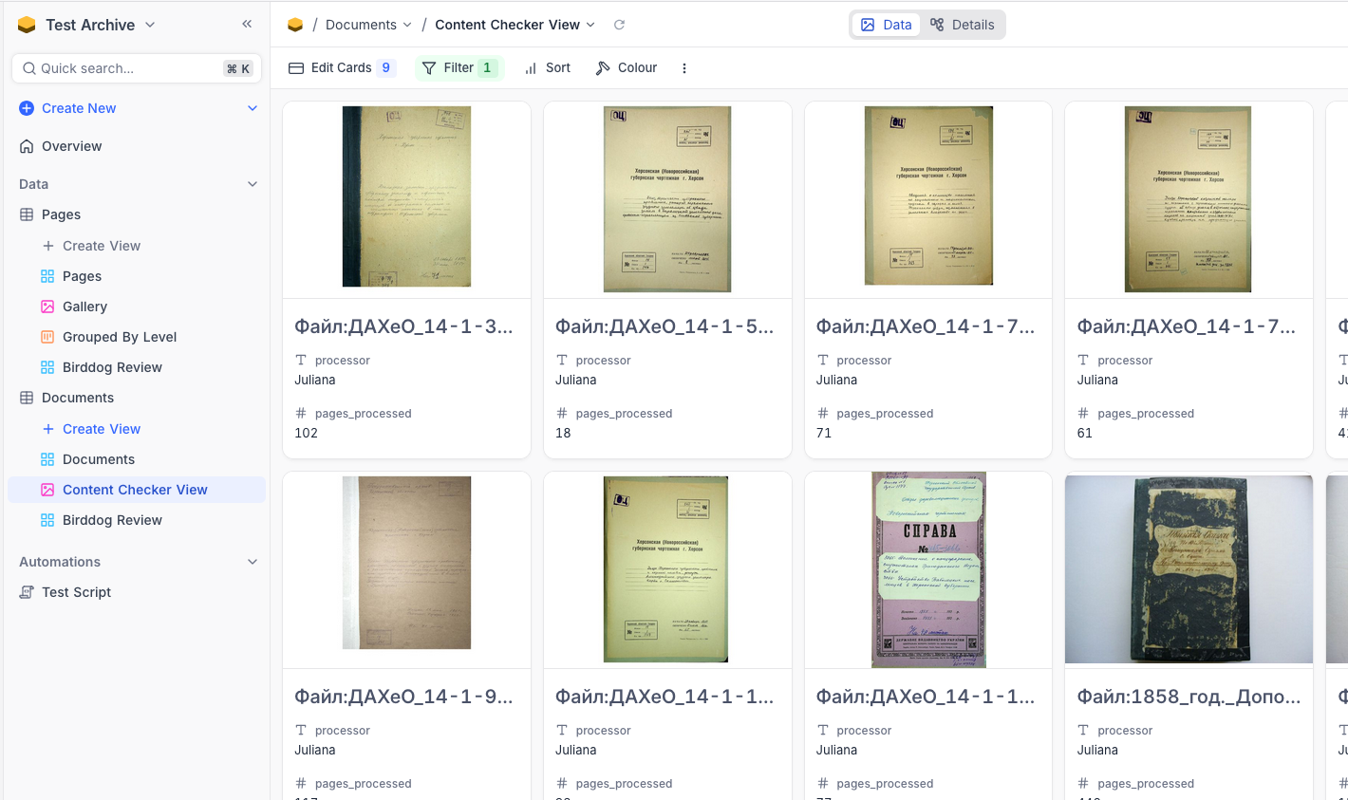
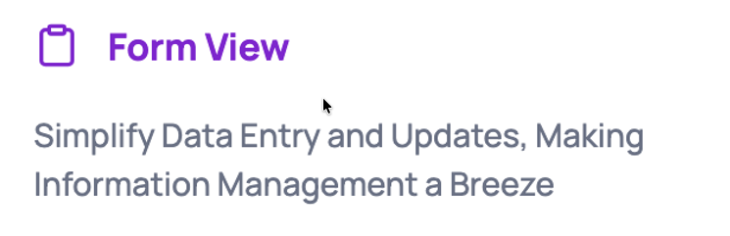
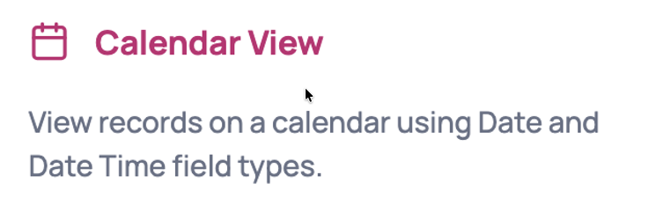
Customizable Views

Slide 8
Database Schema
Separate Page data from Scanned Document data
“Page”
A Wiki or Archive web page
Title
URL
Level (archive, fund, opus, case)
Availability (linked, unlinked)
Parent (page)
Children (pages)
Documents
“Document”
An attached scanned document
Document link
Document type
Content code
Process code
Processor
Pages processed
Owning page

Slide 9
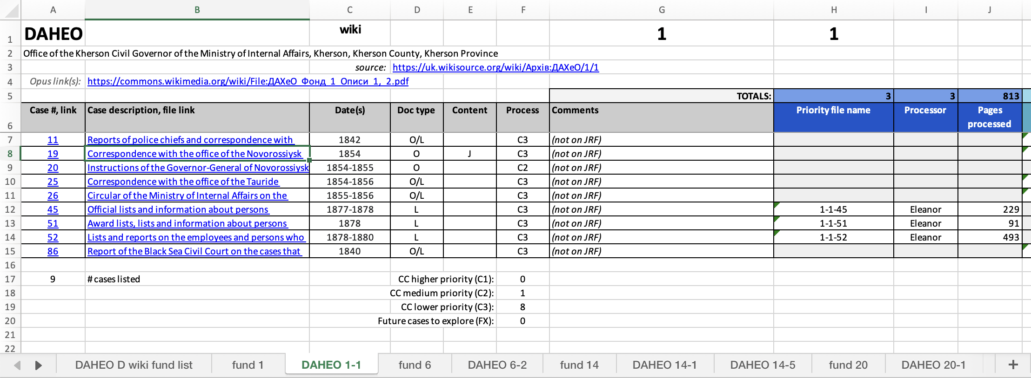
Mapping Spreadsheet Columns to Database Schema
Page Data
Document Data
Document Links

Slide 10
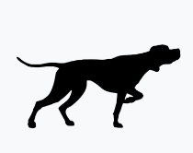


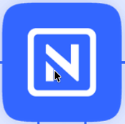
Development Strategy
Ongoing Work
Google Drive
Wikisource
Birddog
Validate the platform choice incrementally.
Information gathering from team(s)
Birddog integration experiments
Identify and flesh out roles and views
Develop in parallel with ongoing Google Drive-based workflows.
Transition when we’re ready.
Snapshots
Database
Database Development

Slide 11
Development Status
Ongoing Work
Google Drive
Wikisource
Birddog
Snapshots
Birddog Integration - automatic updates from Wiki
Data import from spreadsheets
Database
Database Development
Workflow development (views, roles, streamlining)

Slide 12

Transition Process
Existing Google docs spreadsheet content is imported into the database to start.
Google docs continues to be used during the transition period.
Individual archive tracking is sequentially cut over to the database when ready.
Birddog is integrated to insert database updates based on ongoing Wiki archive changes.

Slide 13
Key Concept
Separation of Views from Data
Data
Views

Slide 14
Database Requirements
Low cost
Multi-user
Easy learning curve
Sufficient variety of views
Coexists with Birddog and Google Drive
Easily grow and transform with evolving needs
No lock-in: possible to migrate out down the road
Role-based access rights

Slide 15
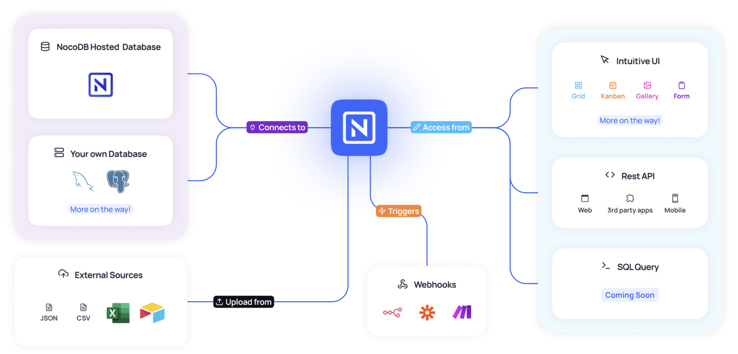
NocoDB Features

Slide 16
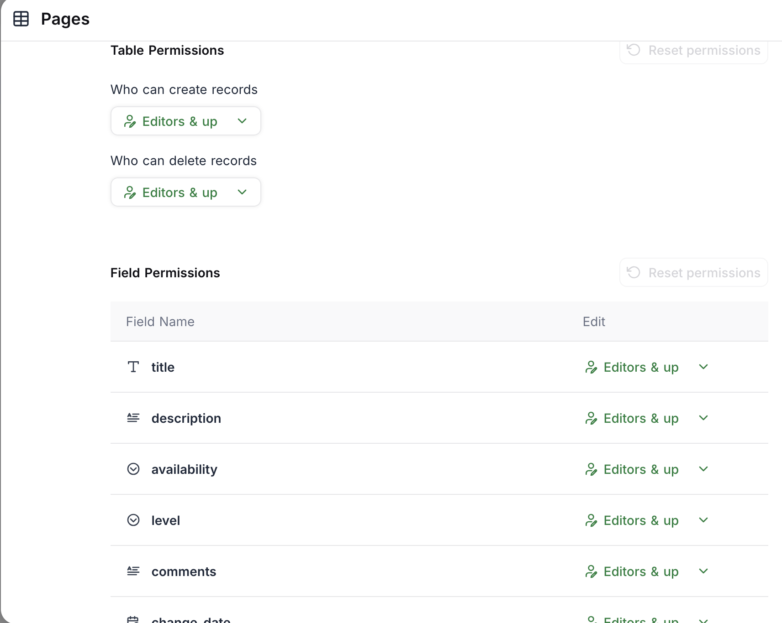
Role-Based Data Access Permissions

Slide 17
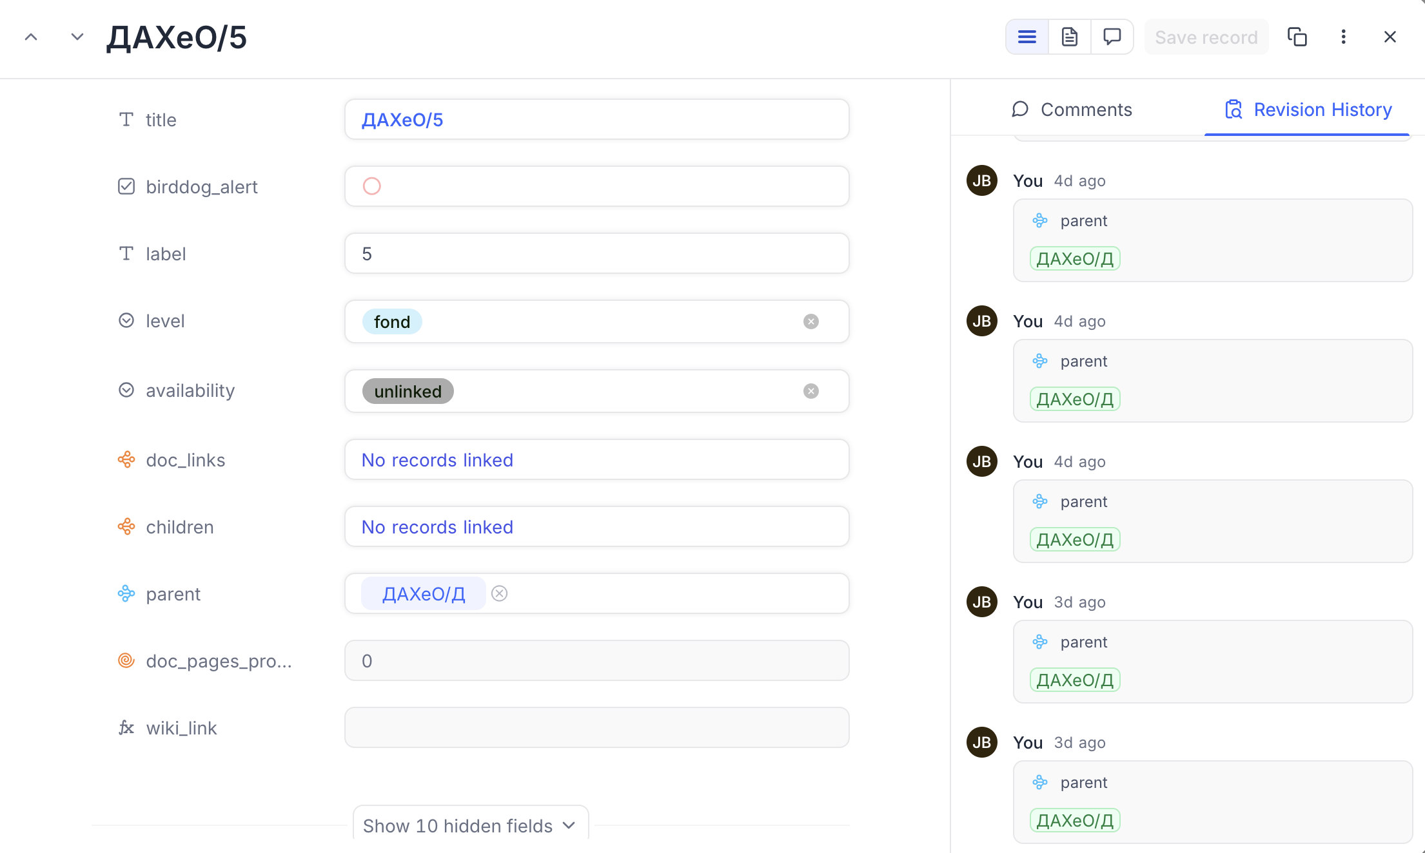
Revision History for All Data Changes

Slide 18
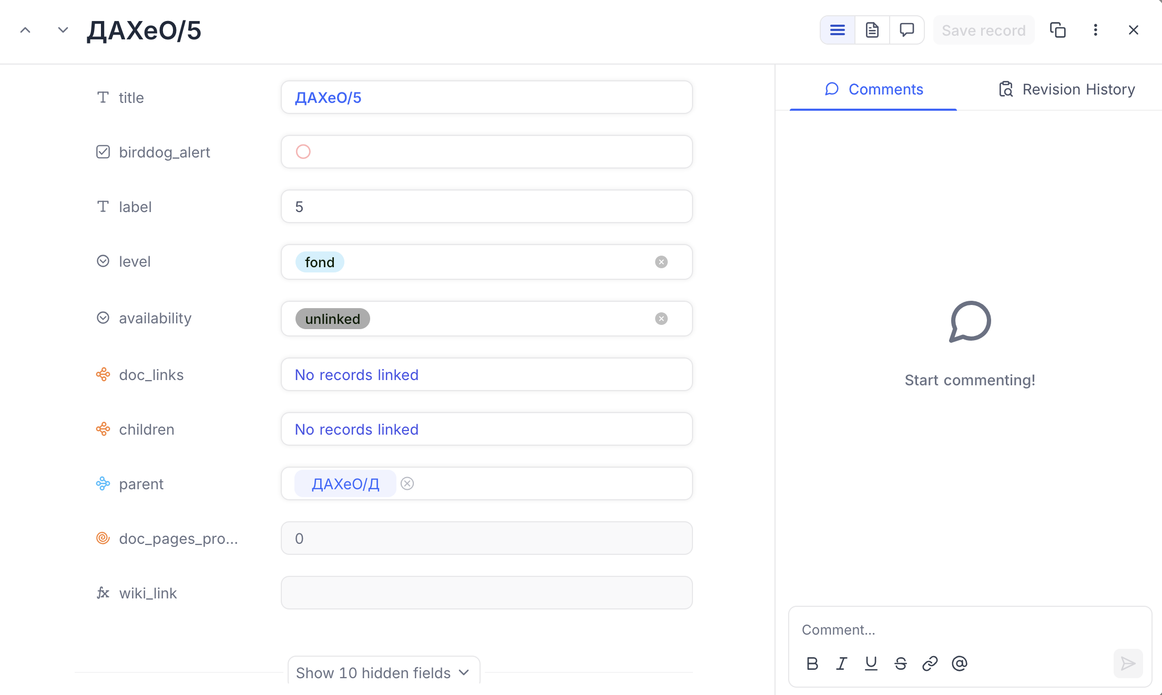
Per-Record Commenting

Slide 19
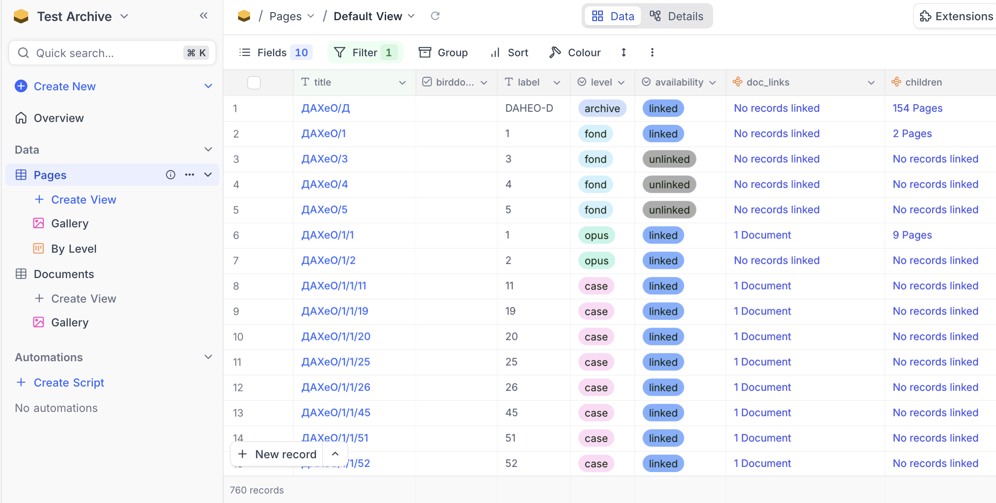
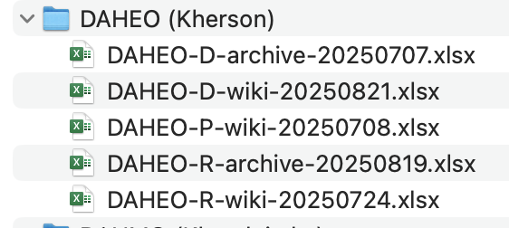
Initial Experiment with DAHEO

Slide 20
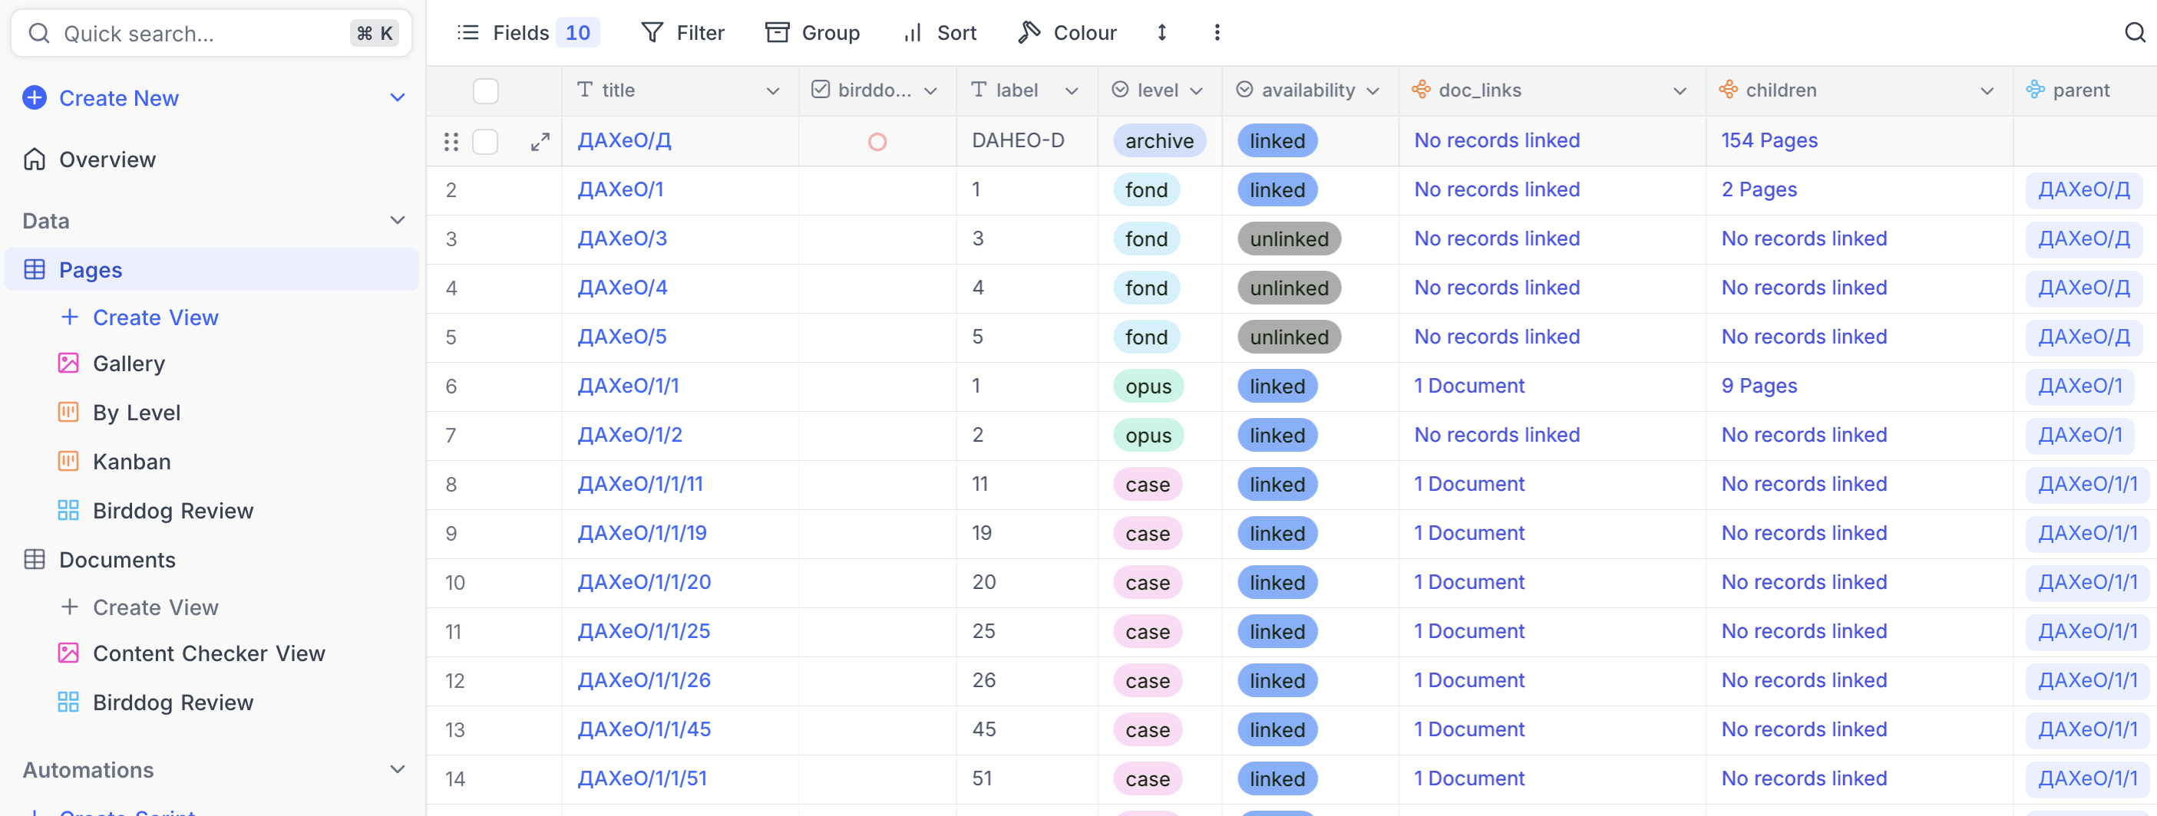
Pages Table

Slide 21
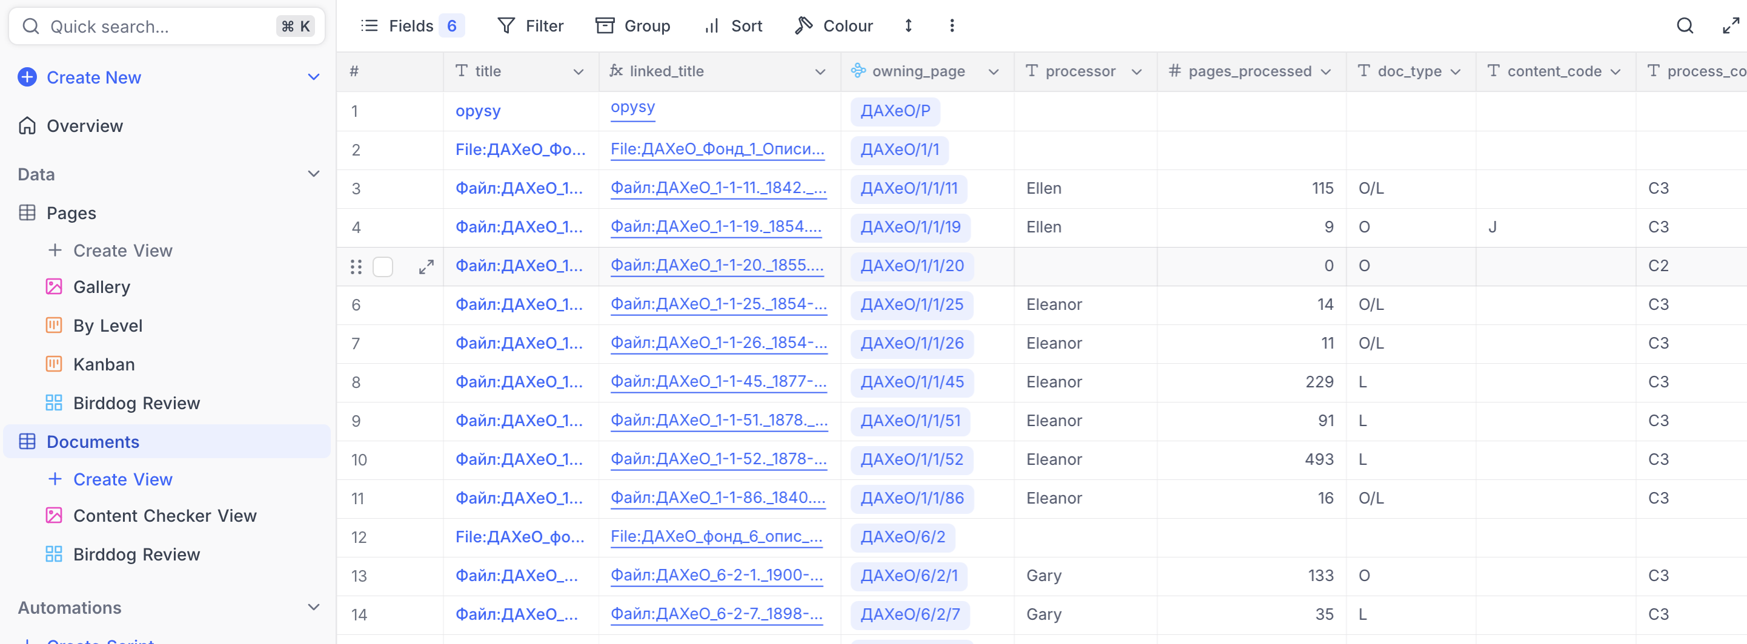
Documents Table

Slide 22
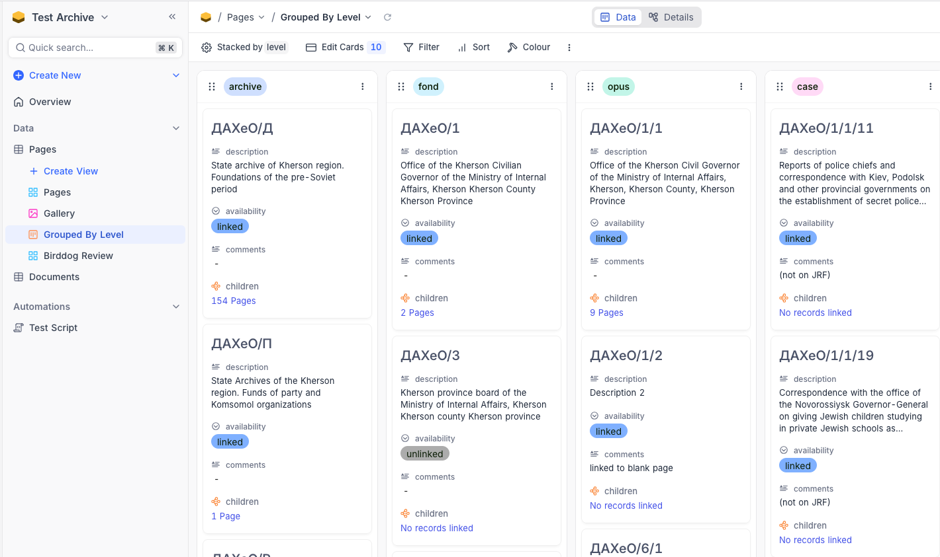
'Kanban” View of Pages table

Slide 23
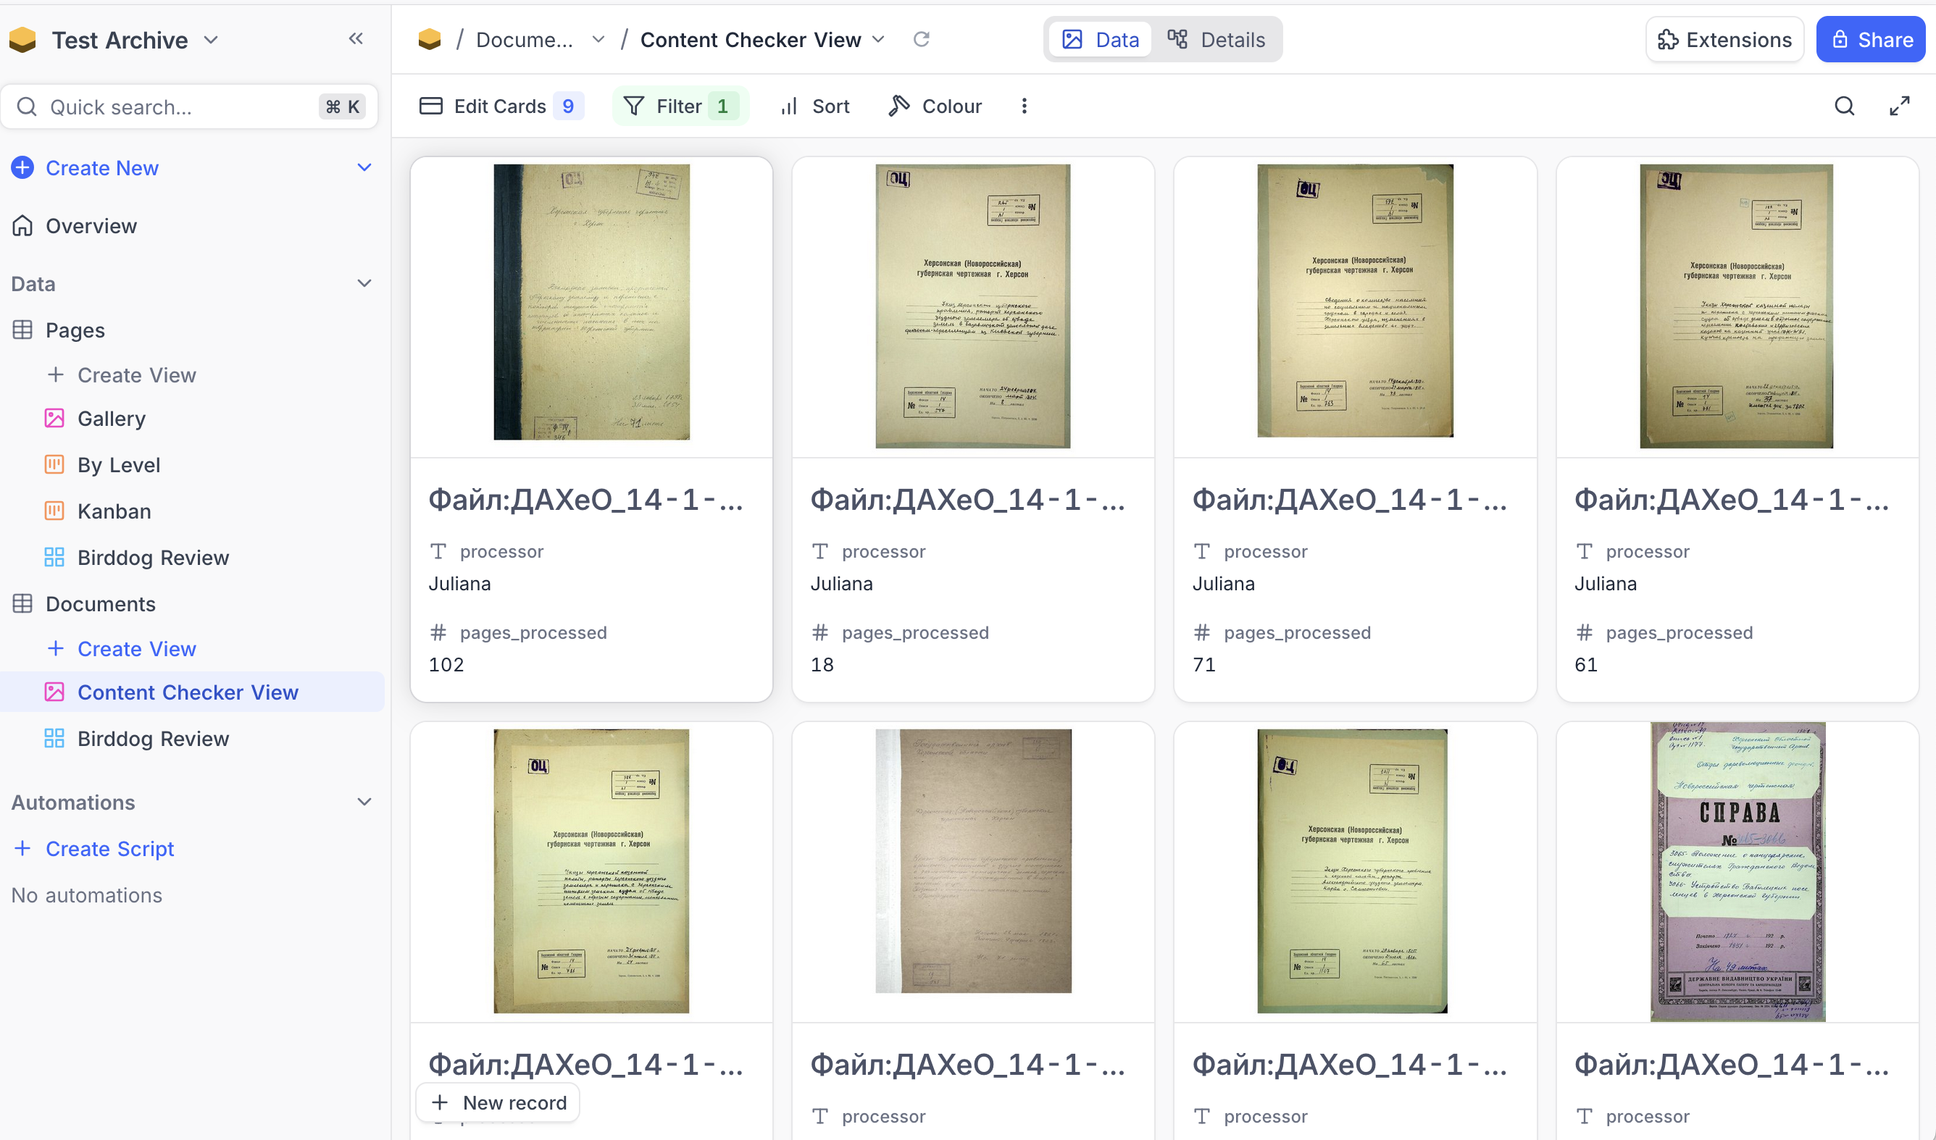
Gallery View for Content Checkers

Slide 24
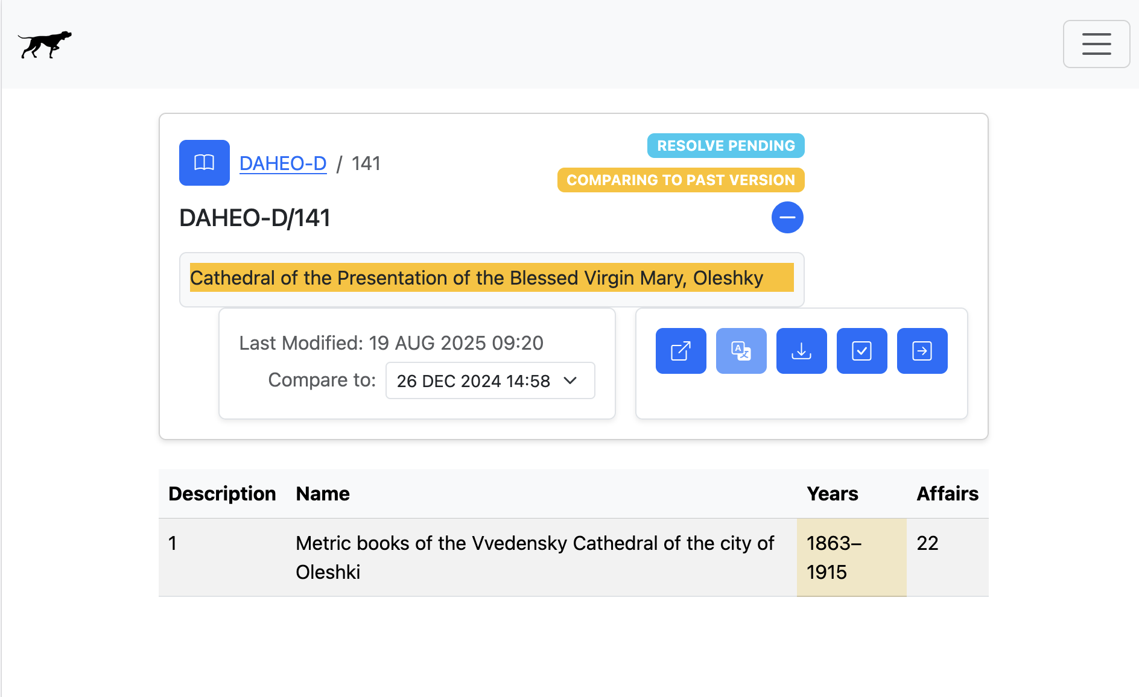
Birddog Integration (NOT YET!)
“Update database”

Slide 25
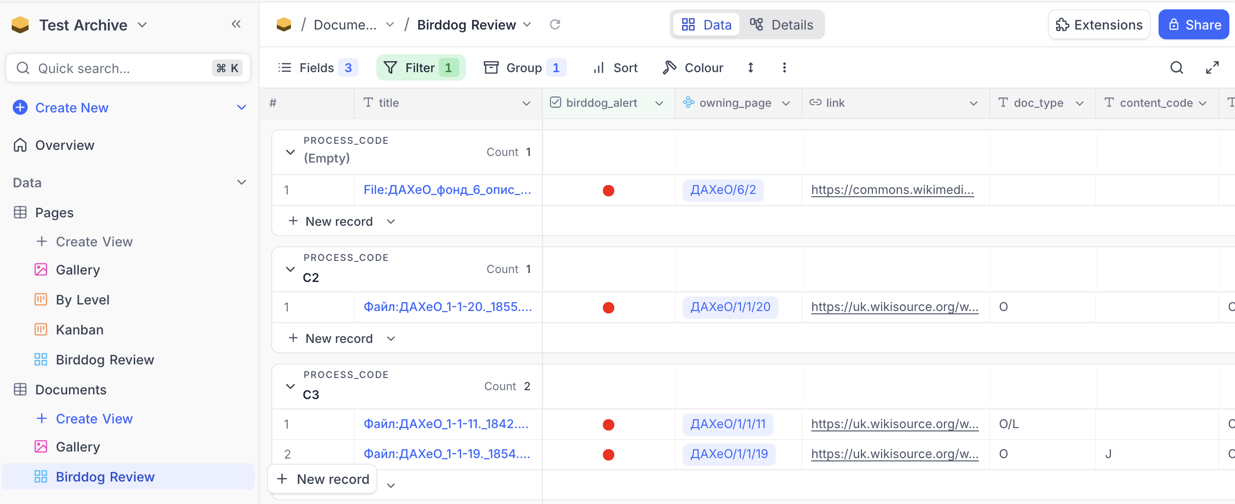
Mock-Up View for Reviewing Birddog Updates

